Slide 1
Impact of Elevated Base Stations on the Ultra-Dense Networks
Hewon Cho, Chenxi Liu, Jemin Lee , Taegyun Noh, and Tony Q. S. Quek
BongSang Kim
School of Undergraduate studies
Daegu Gyeongbuk Institute of Science and Technology (DGIST)
tph02361@dgist.ac.kr
April. 25, 2019
UGRP

Slide 2
Keywords
Elevated BSs
LoS(Line of Sight)/NLoS
Stochastic geometry
Coverage probability

Slide 3
UDN Characteristics
-The distance between BS and UE is small
The height of BSs cannot be ignored
The possibilities of having LoS propagation increases.
Notes:
모바일 사용자의 트래픽 수요가 폭등하면서 5G에서는 주요 후보 기술 분야로 기지국 간 거리가 매우 가까운 초고밀도 네트워크가 있다.
UDN에서 상대적으로 많은 기지국들을 통해서 높은 주파수 효율과 데이터 전송 속도를 보장할 수 있다.

Slide 4
Former studies models
Assumption: the probability of LoS propagations decreases as the antenna height of BSs increases -unlikely to be valid in practice
- BSs with a higher height are more likely to establish the LoS path towards the UEs.
Assumption: equal height for all BSs-not realistic.
→heights of buildings should be different and random
Notes:
Ideal Backhaul: 2.5$μsec$ 이하의 지연과 10Gbps 이상의 capacity를 갖는 backhaul
Non-ideal Backhaul: 5~30 msec (혹은 그 이상)의 지연을 갖는 backhaul

Slide 5

System Model
Single-antenna BSs and single-antenna Ues are randomly distributed.
Modeled as PPPs(Poisson point processes) respectively($Φ_{BS}$ and $Φ_{UE})$
each BS has at least one UE associated in its coverage for simplicity

Slide 6



System Model-Network Description
All BSs have their antennas at the height $l$
All UEs are on the ground
Each BS supports one UE using time and frequency with the same transmission power.
each BS has a LoS/NLoS path to associated UE with probability

Slide 7

System Model-Network Description
Consider both fading and path loss
LoS/NLoS propagation experiences Nakagami-m fading
*LoS: Rician fading
*NLoS: Rayleigh fading
Path loss exponent ${2<α}_{L}≤α_{NL}≤4$
Notes:
NLoS transmission: $P_{cov}$ is independent with the BS density $λ$ when $λ$ is large enough.
Increase in interference and signal power cancel each other
NLoS transmission: ASE increases linearly with the BS density $λ$.
$P_{cov}$ is invariable with respect to $λ$

Slide 8

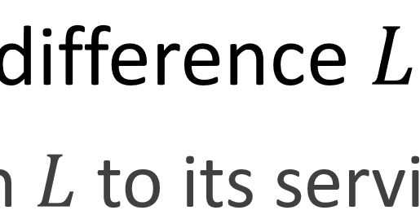
BS Association Rule
the path loss exponents are different for LoS and NLoS propagations
→the signal strength of the nearest BS is not always the strongest one
cf) conventional model : the signal strength of the nearest BS is the strongest one
Consider BS with average strongest received power.

Slide 9
BS Association Rule
Conventional PDF of the distance between UE and BS canoot be applied to the system.
Should be consider LoS/NLoS propagation respectively.

Slide 10
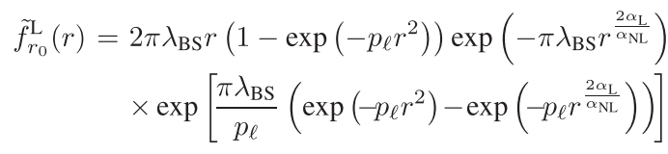
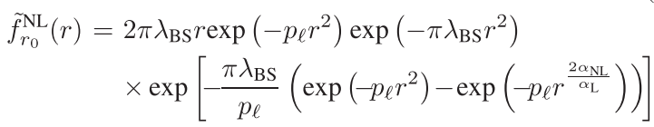

BS Association Rule
The approximated PDFs of $r_{0}$
LOS
NLOS
$p_{l}$ : tunable value determined by the BS height $l$
Notes:
Serving BS가 BS height 보다 더 가까이 있을 수는 없기 때문에 Signal power는 제한되지만, BS 밀도가 높아지면서 Interfering BS의 개수가 많아져 Interference power는 더 높아져 결과적으로 coverage probability와 ASE는 BS높이가 높아짐에 따라 감소하게된다.

Slide 11

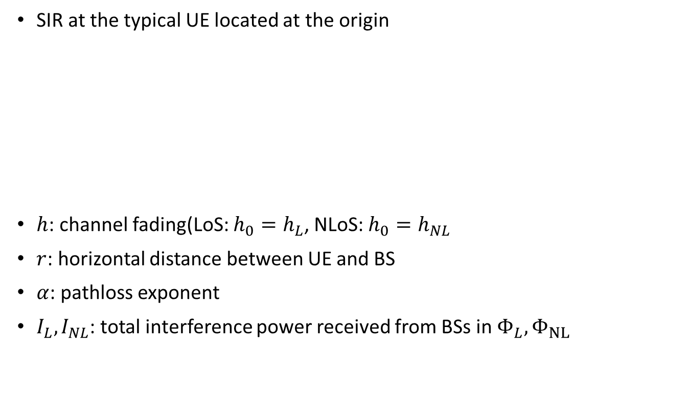
Signal-to-Interference Radio
SIR at the typical UE located at the origin
$h$: channel fading(LoS: $h_{0}=h_{L}$, NLoS: $h_{0}=h_{NL}$
$r$: horizontal distance between UE and BS
$α$: pathloss exponent
$I_{L}, I_{NL}$: total interference power received from BSs in $Φ_{L}, Φ_{NL}$

Slide 12
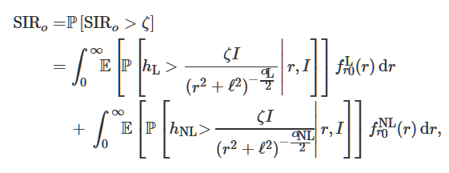
Coverage Probability analysis
The coverage probability of the system is

Slide 13
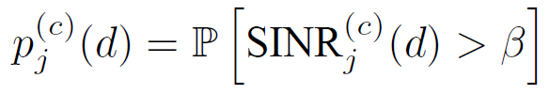

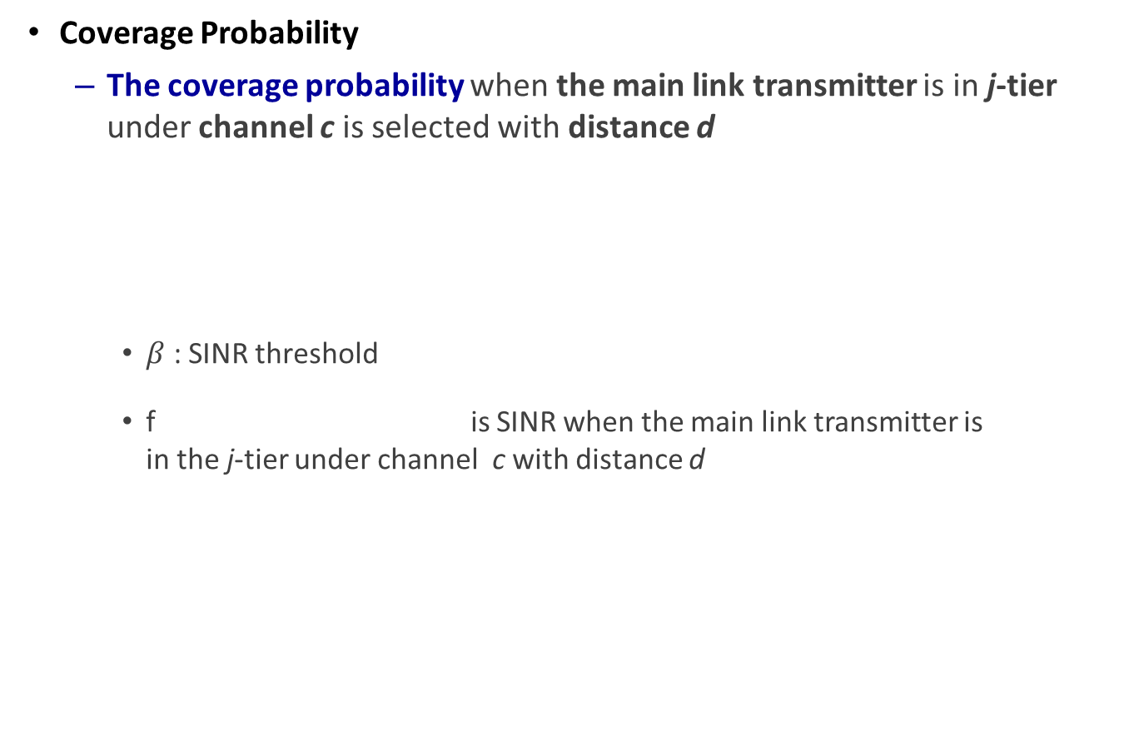
Remark: Coverage Probability Analysis
Coverage Probability
The coverage probability when the main link transmitter is in j-tier under channel c is selected with distance d
$β$ : SINR threshold
f is SINR when the main link transmitter is in the j-tier under channel c with distance d

Slide 14
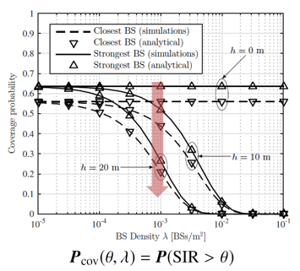
Numerical Results

Slide 15
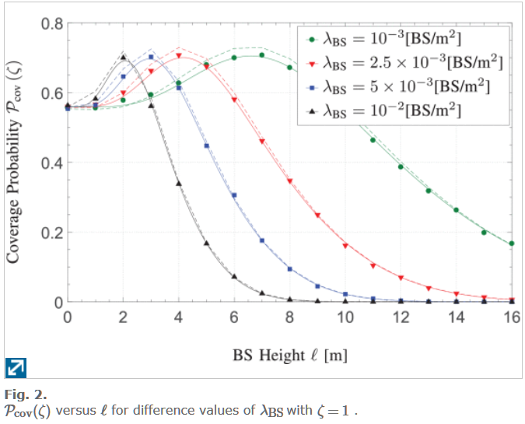
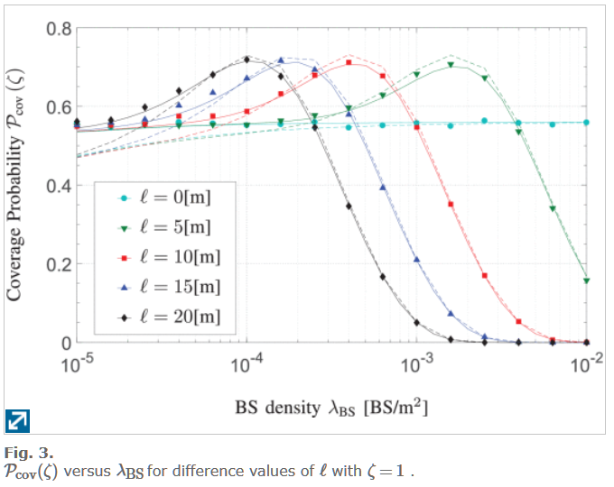
Numerical Results

Slide 16
Questions?
Thank you

